Slide 1

Pharmacy Management System
Project By
Mohammad Saud (804/727445)
Submitted To:
Sir Nasrullah Nasar
Government Post Graduate College Jhang

Slide 2
Objectives:
Prescription & Order Management: To create a system that allows pharmacists to efficiently manage prescriptions and Orders.
Accurate Medication Stock Control: To ensure that medication is always available when needed, develop a system that accurately tracks and manages medicine stock levels.
User Profile Management: System has User profiles management where each User can easily Update their profiles but each user has limited access over system according to their roles.
Access Control and Security: To implement robust access control and security features to protect sensitive patient and pharmacy data.
Enhanced User Experience: To create a user interface that is intuitive and user-friendly, minimizing the learning curve for both pharmacists and administrators.

Slide 3


Scope:
The User of this System is being able to manage all the necessary activities of Pharmacy. This System is Handling all aspects where it allows Pharmacist to Manage Available Stock of medicines as well as Orders.
Pharmacy Management System Covered the following areas.
Medicines Management
Stock Management
Employees Management
Prescription Management
System Users Management

Slide 4




Software Tools:
Tools & Languages:
Visual Studio 2022
C# with .NET Framework (Front-end & Back-end)
SQL Server (For DB)
+

Slide 5
System Diagrams:
Entity Relationship Diagram
Use Case Diagram
Activity Diagram
Swimlane Diagram

Slide 6
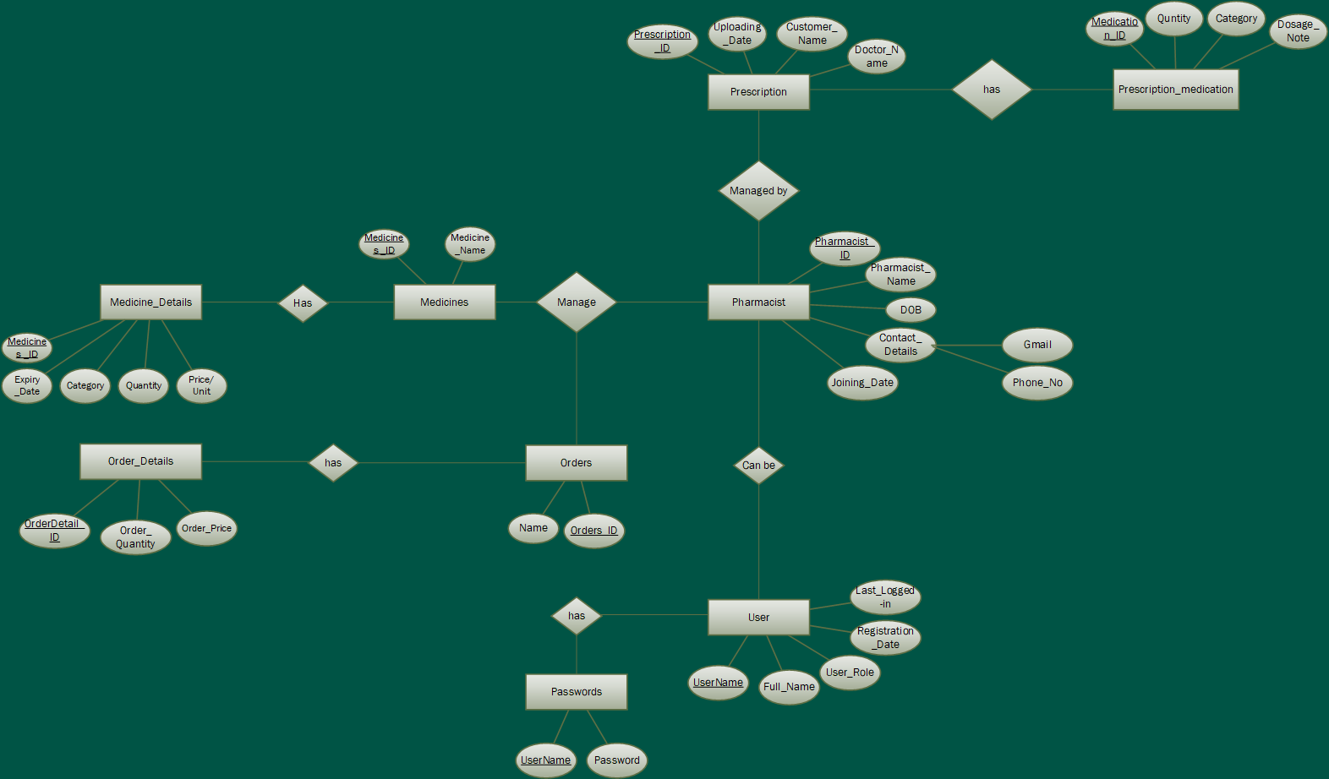
ER Diagram:
ER Diagram:

Slide 7
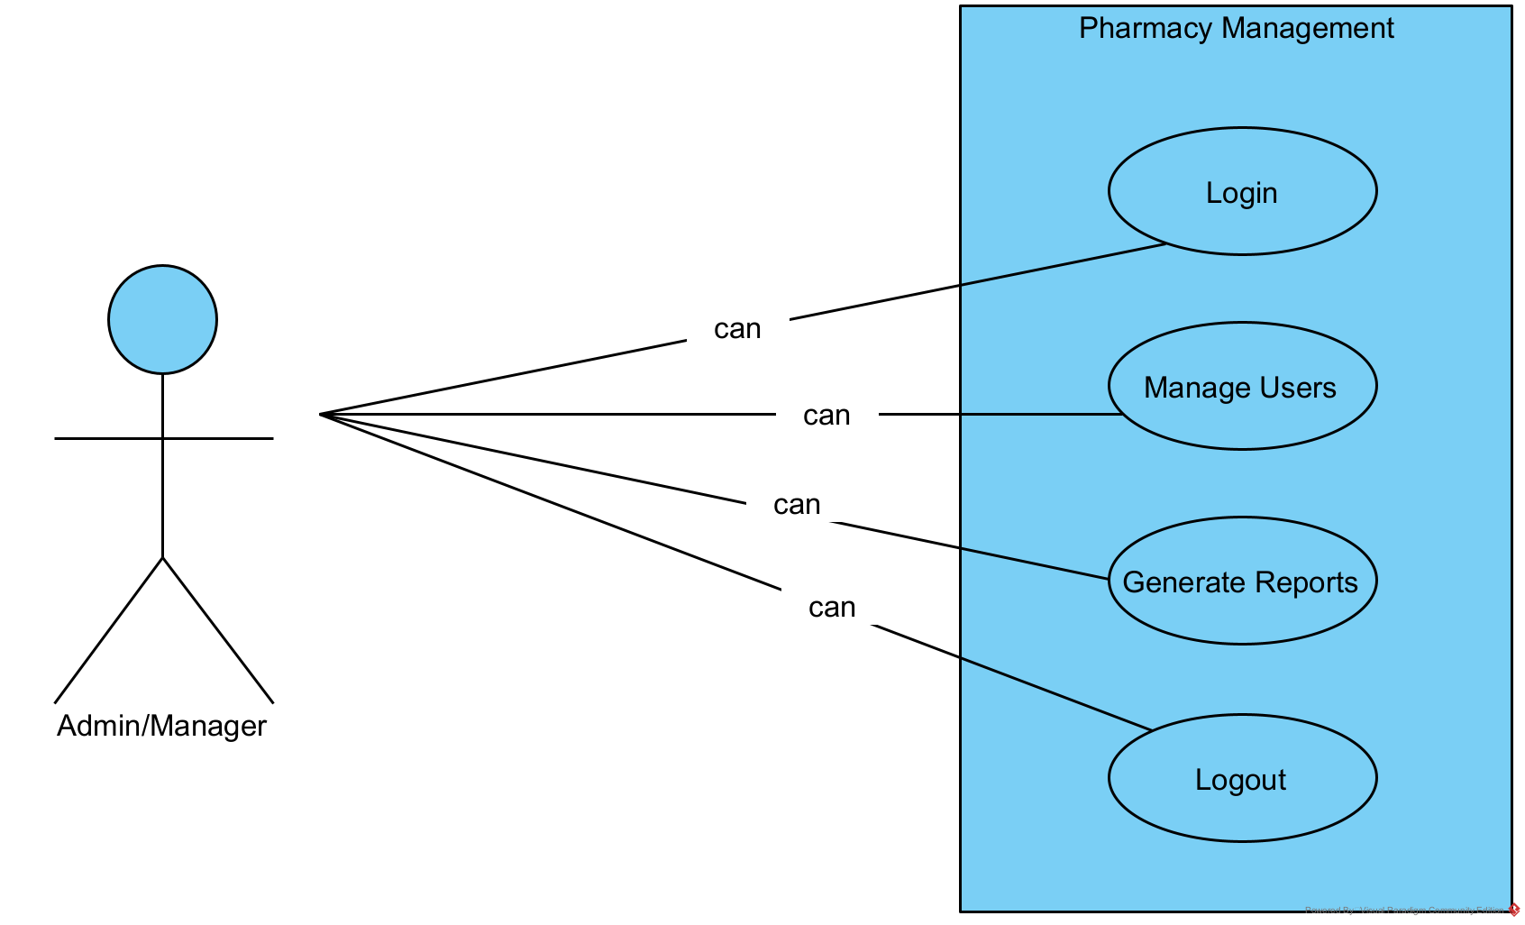
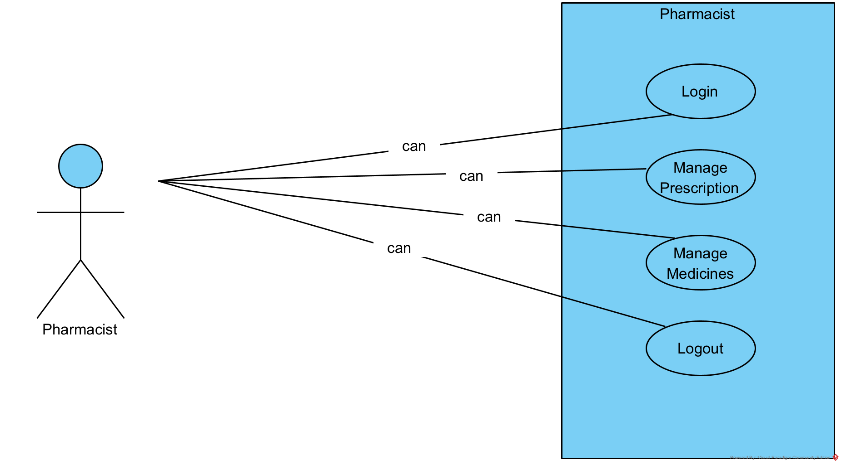
Use Case Diagram:
ER Diagram:

Slide 8
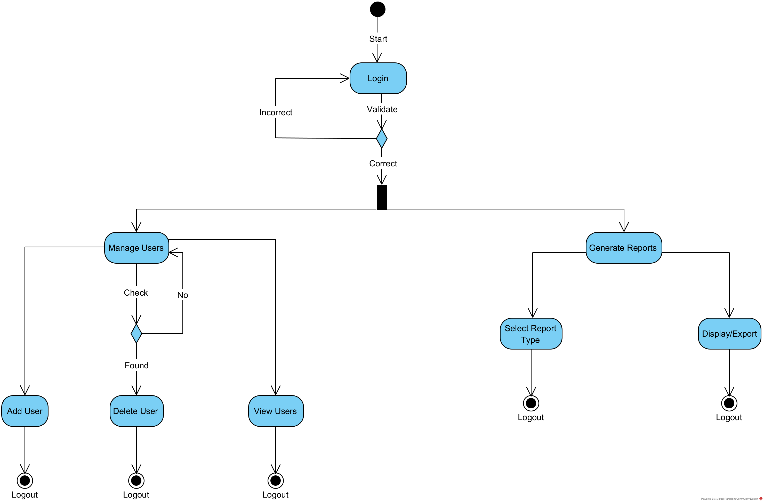
Activity Diagram (Manage Users):
ER Diagram:

Slide 9
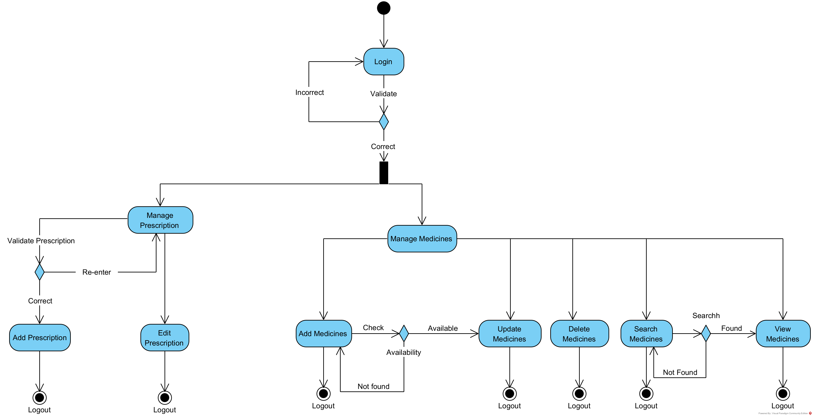
Activity Diagram (Manage Prescription & Medicines):
ER Diagram:

Slide 10
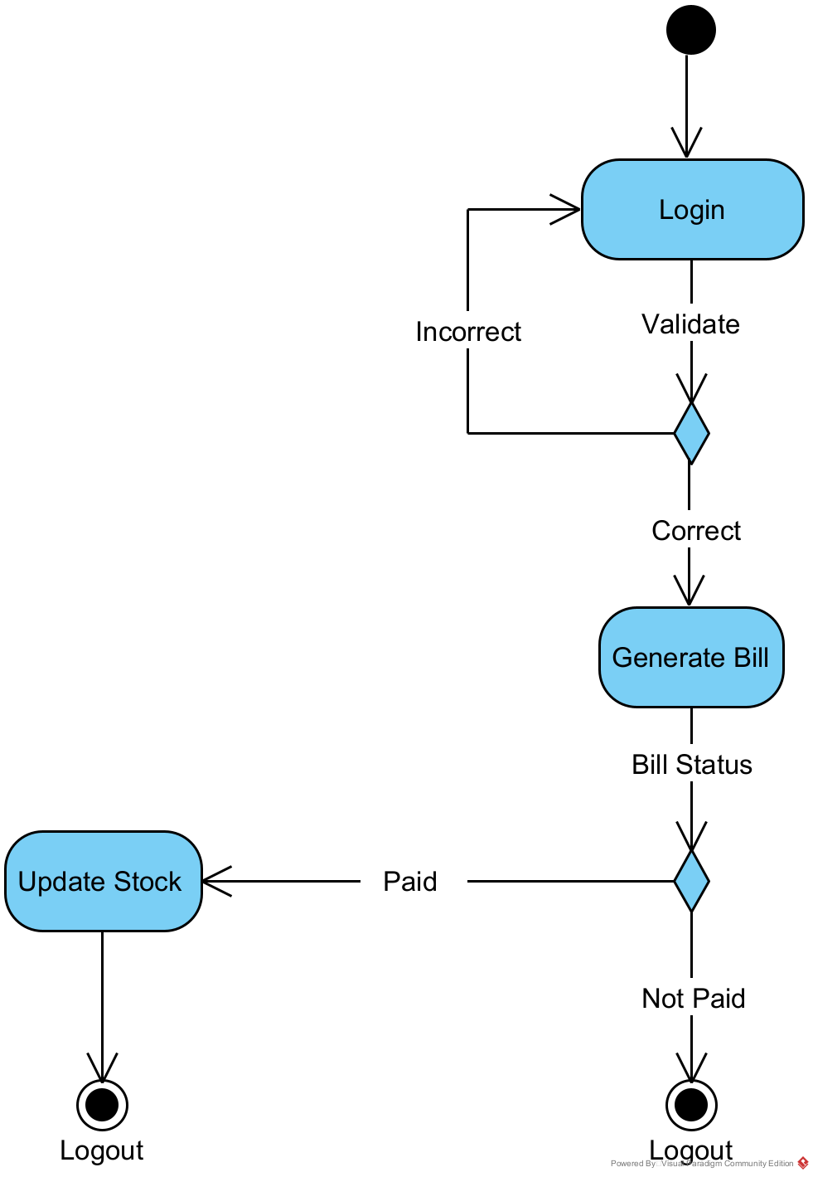
Activity Diagram (Orders & Billing):
ER Diagram:

Slide 11
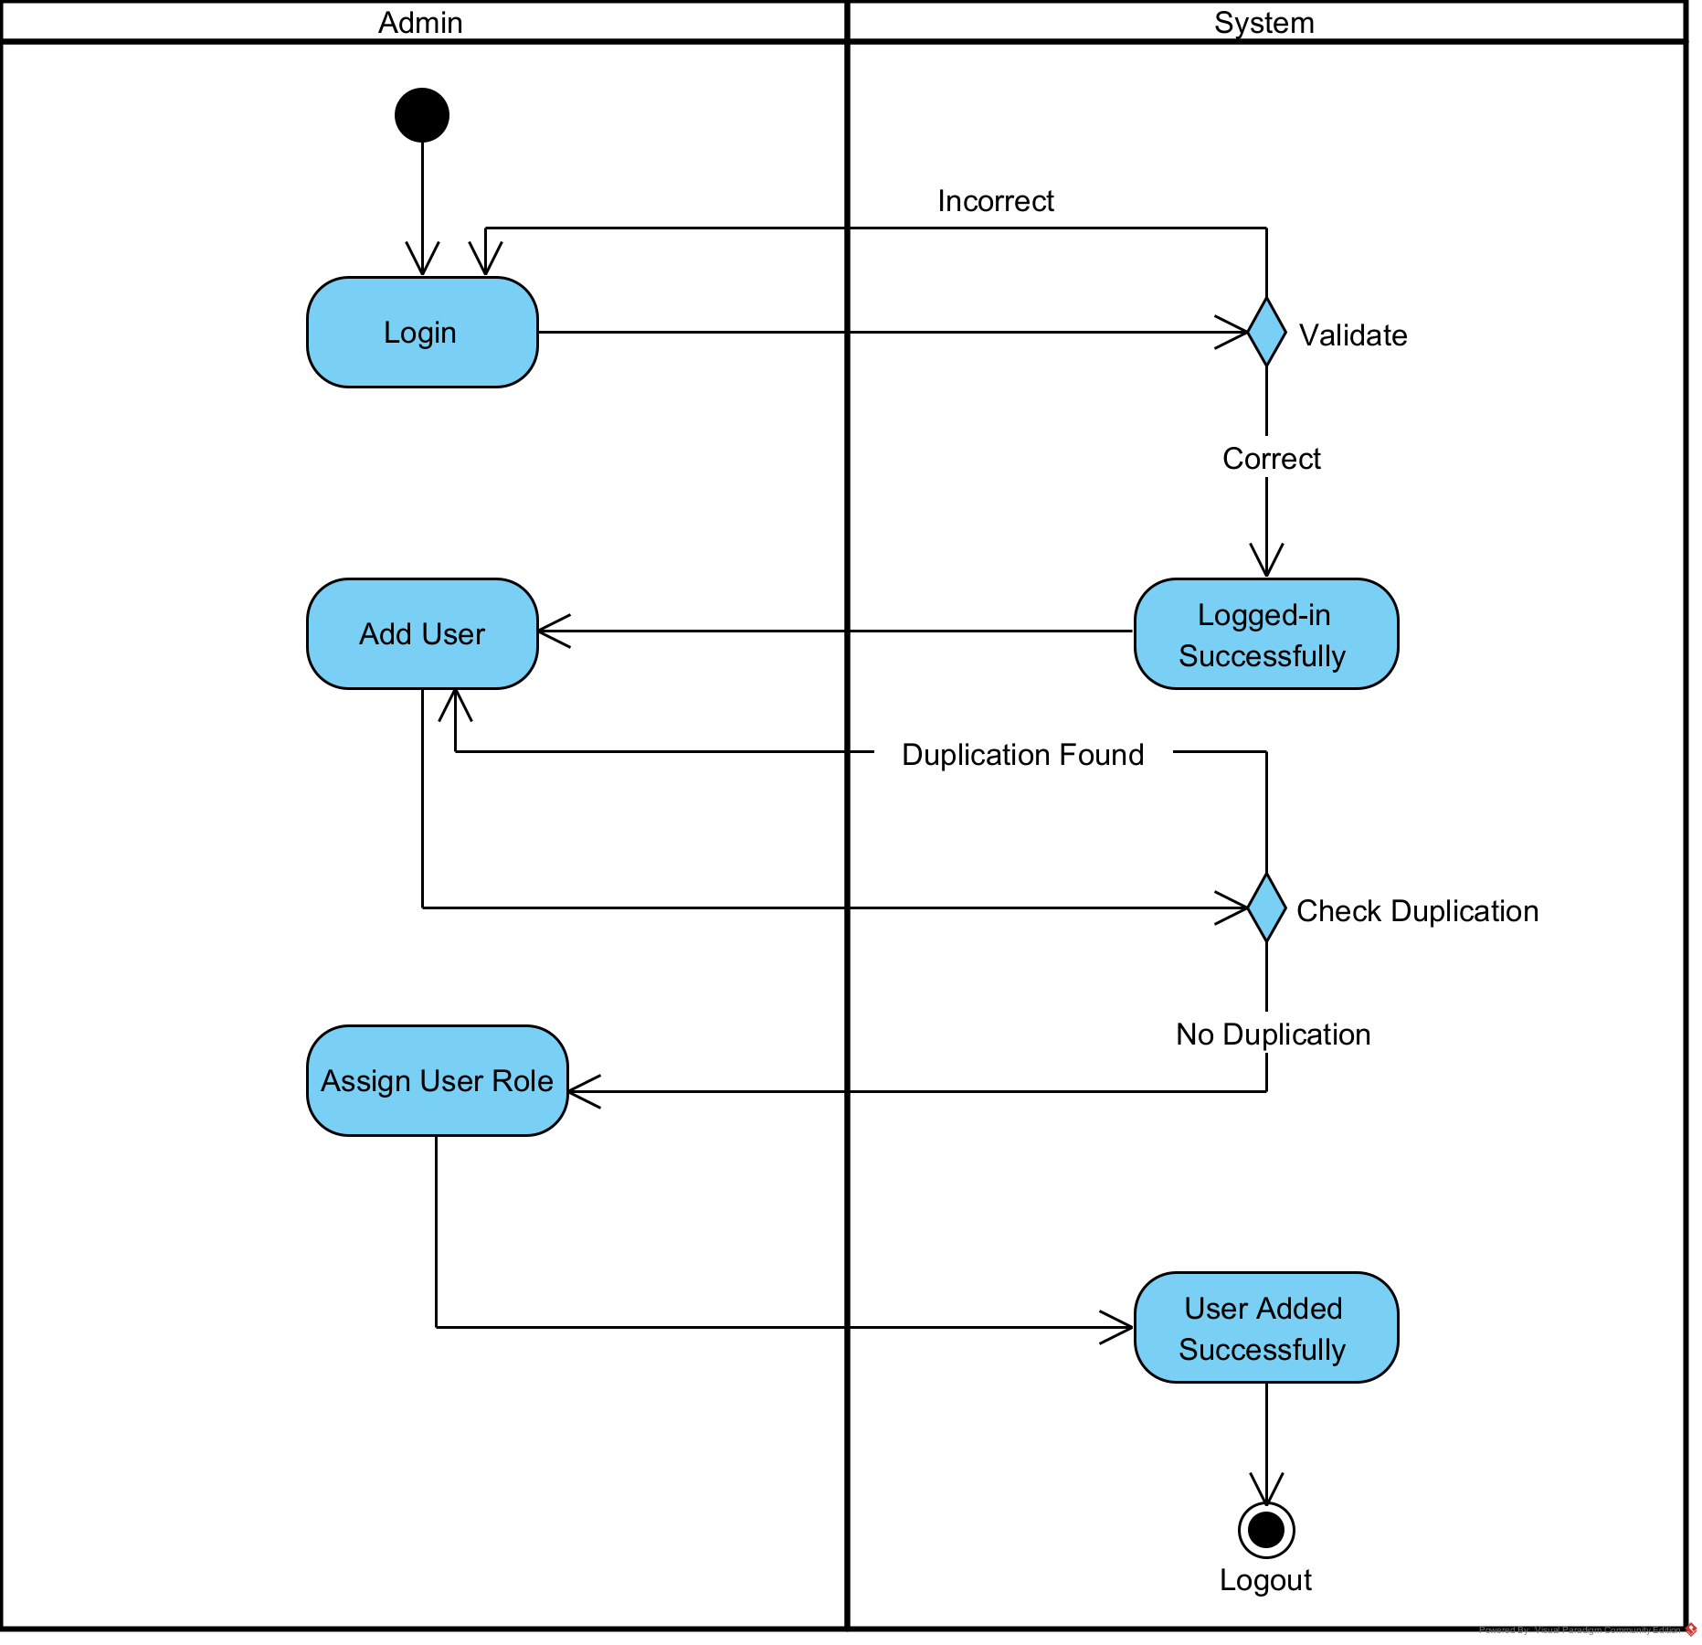
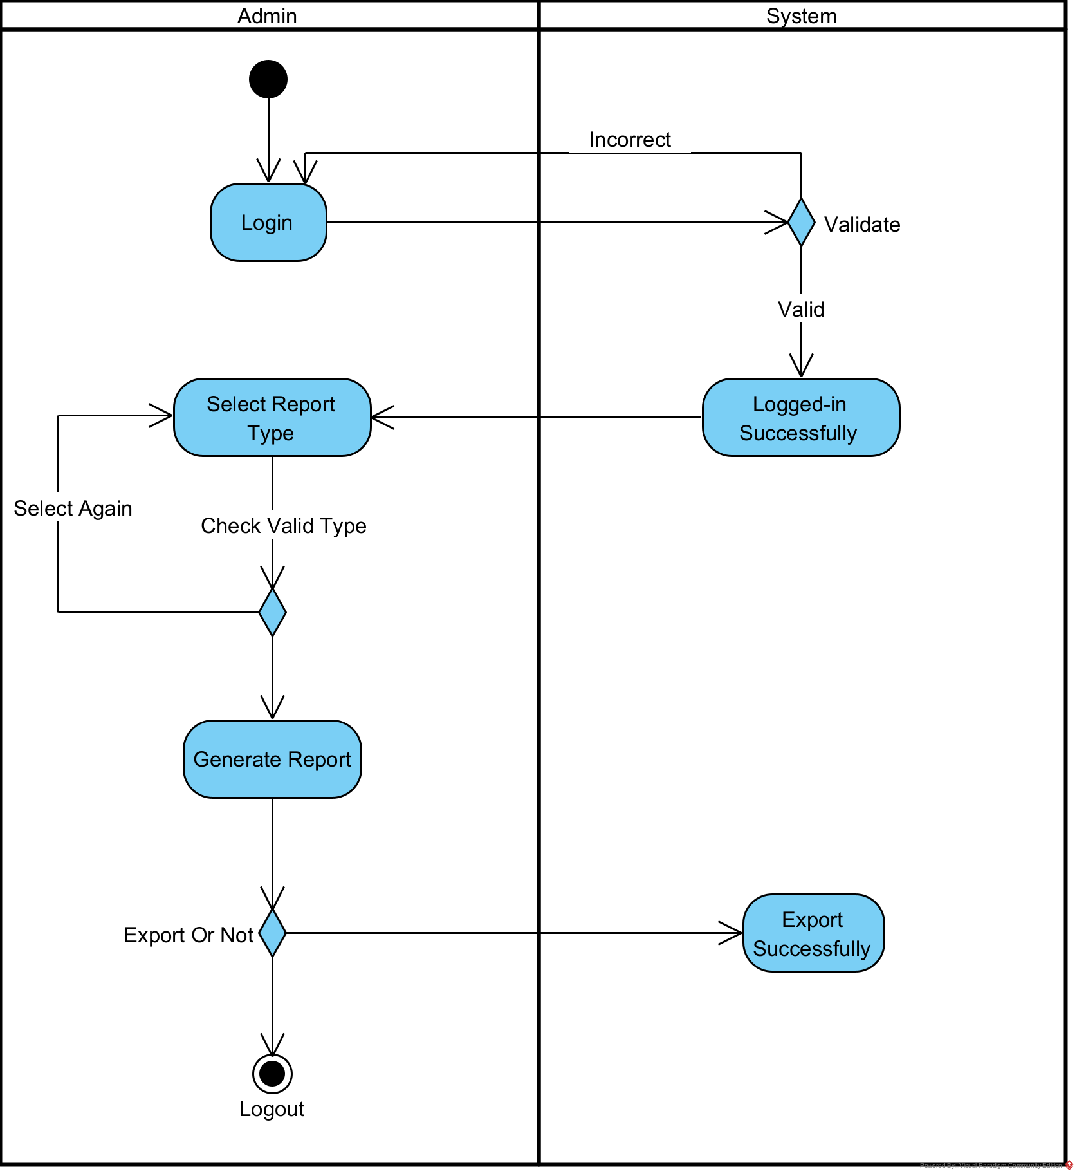
Swimlane Diagram (Manage Users and Reports):
ER Diagram:

Slide 12
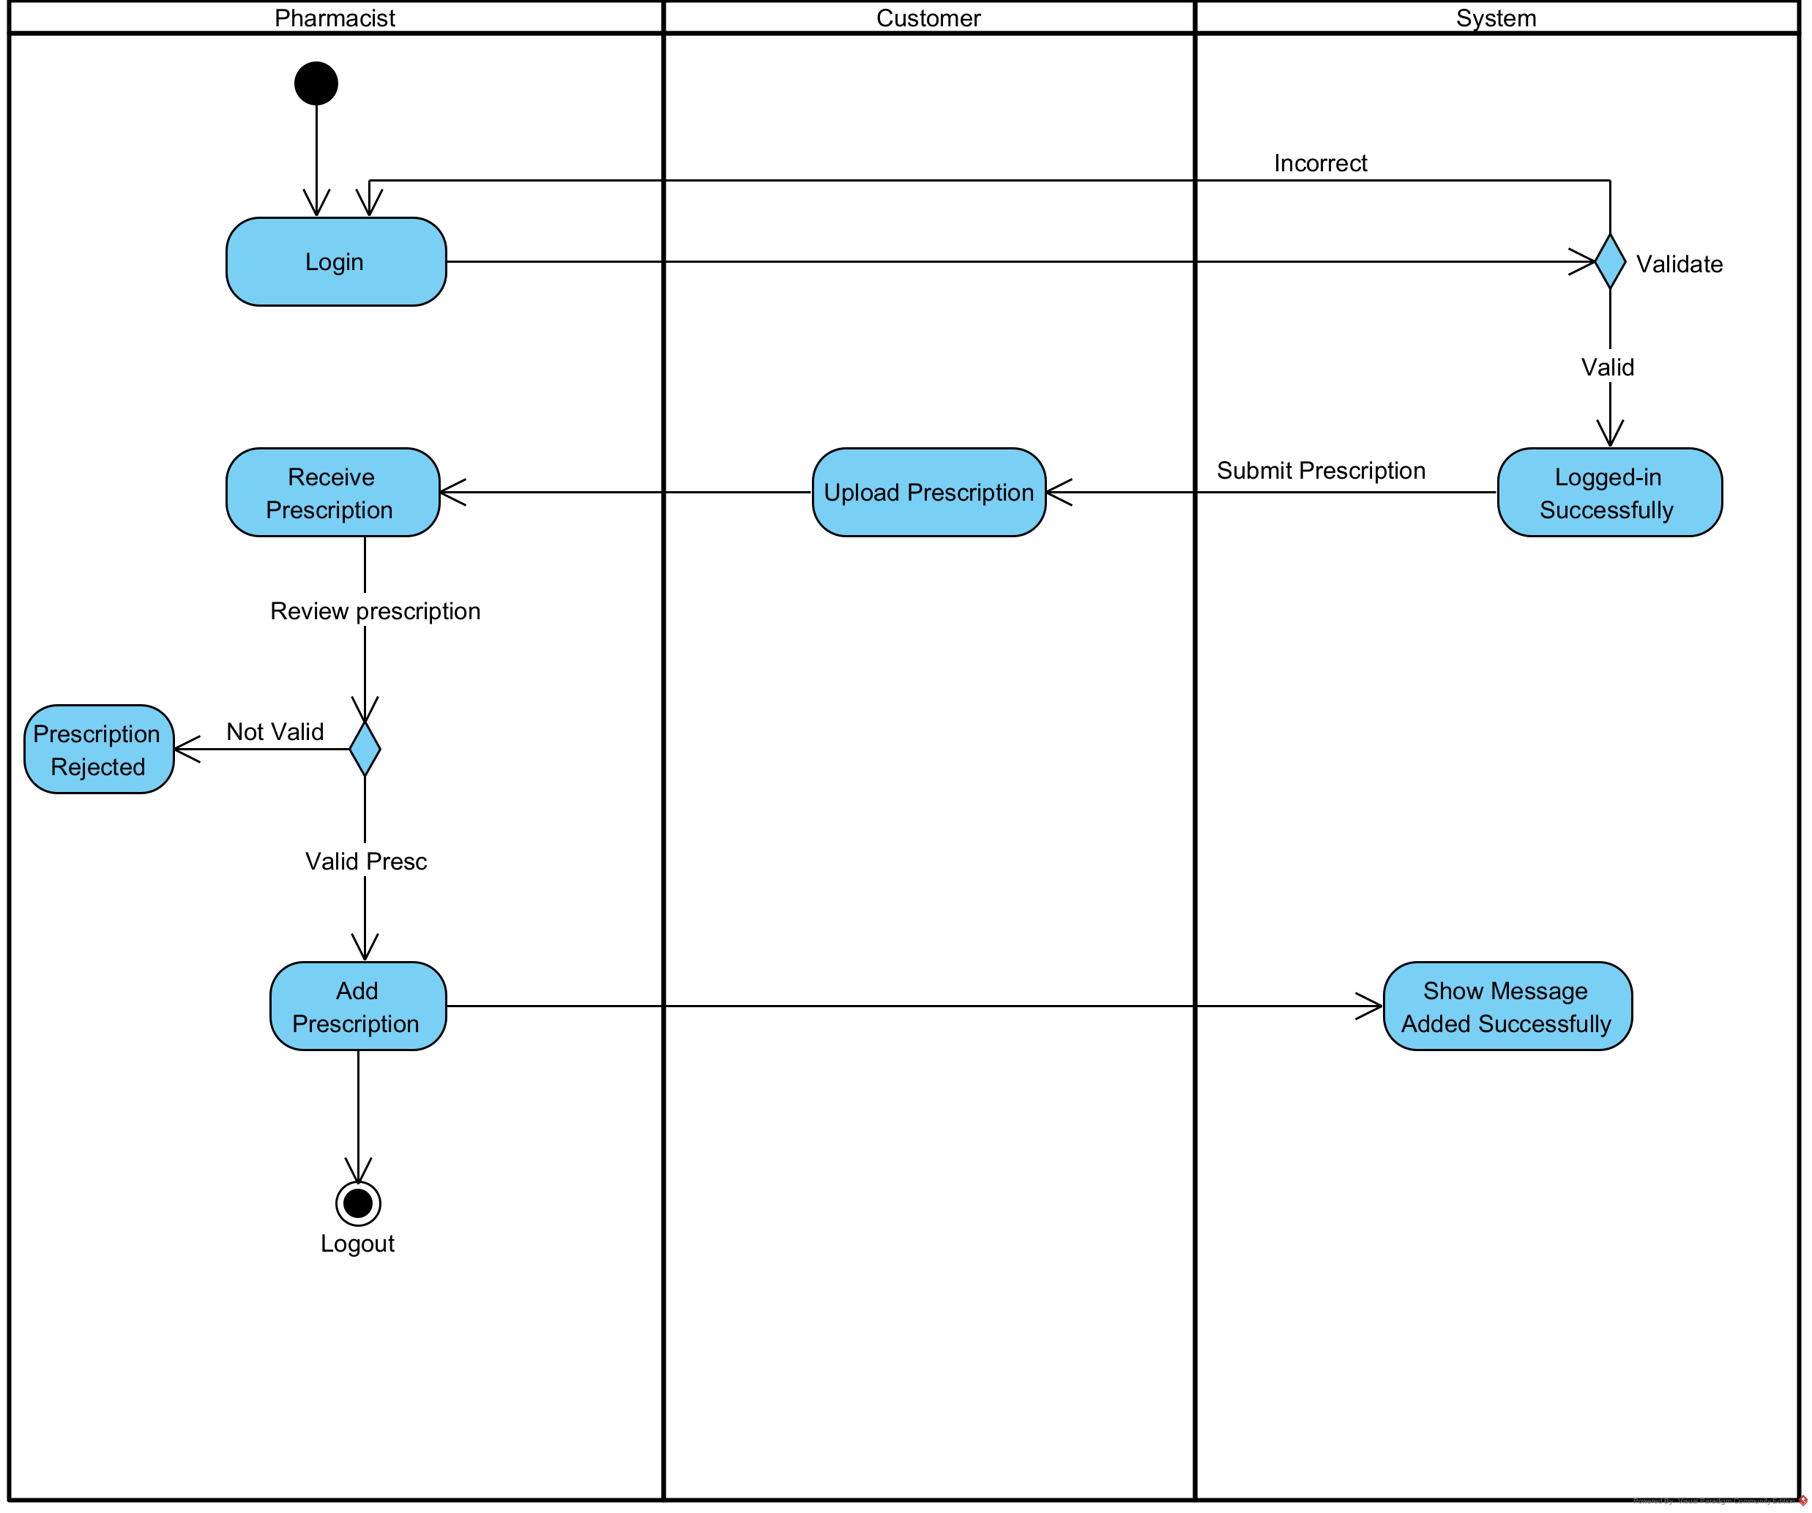
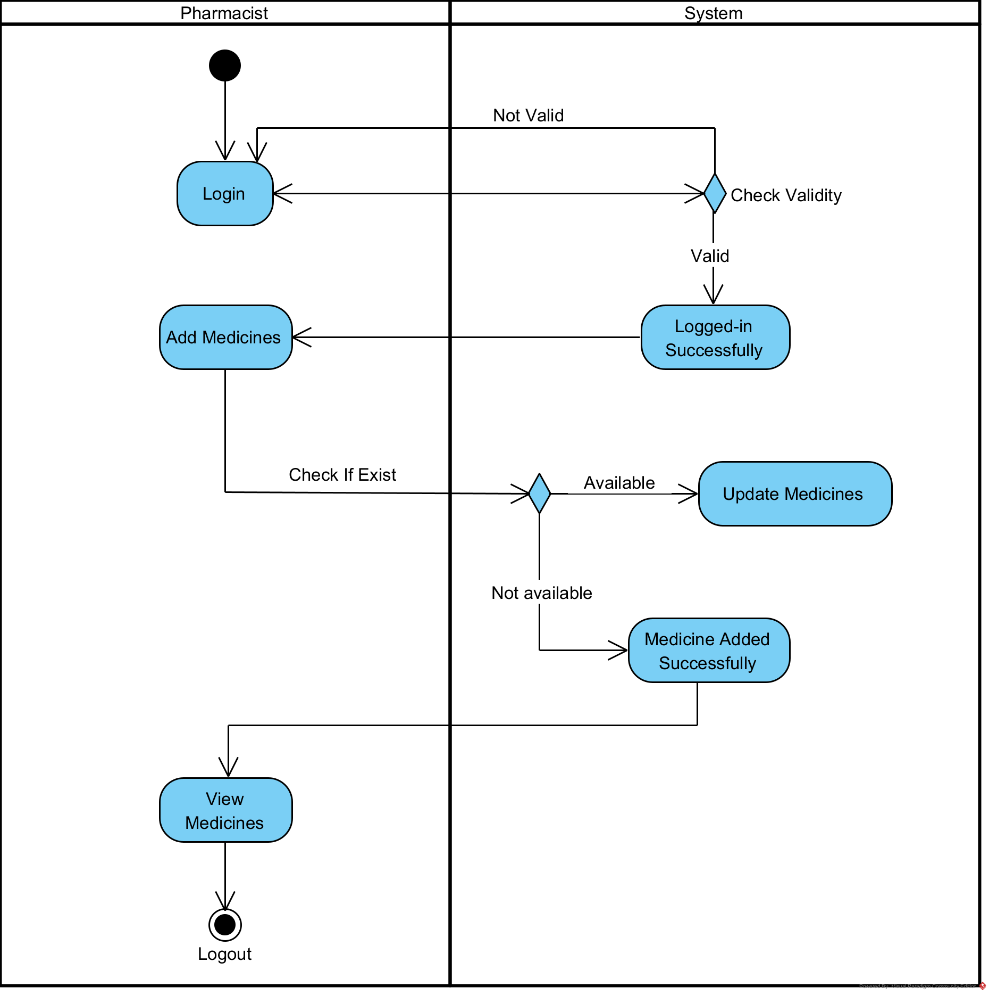
Swimlane Diagram (Prescription):
ER Diagram:

Slide 13
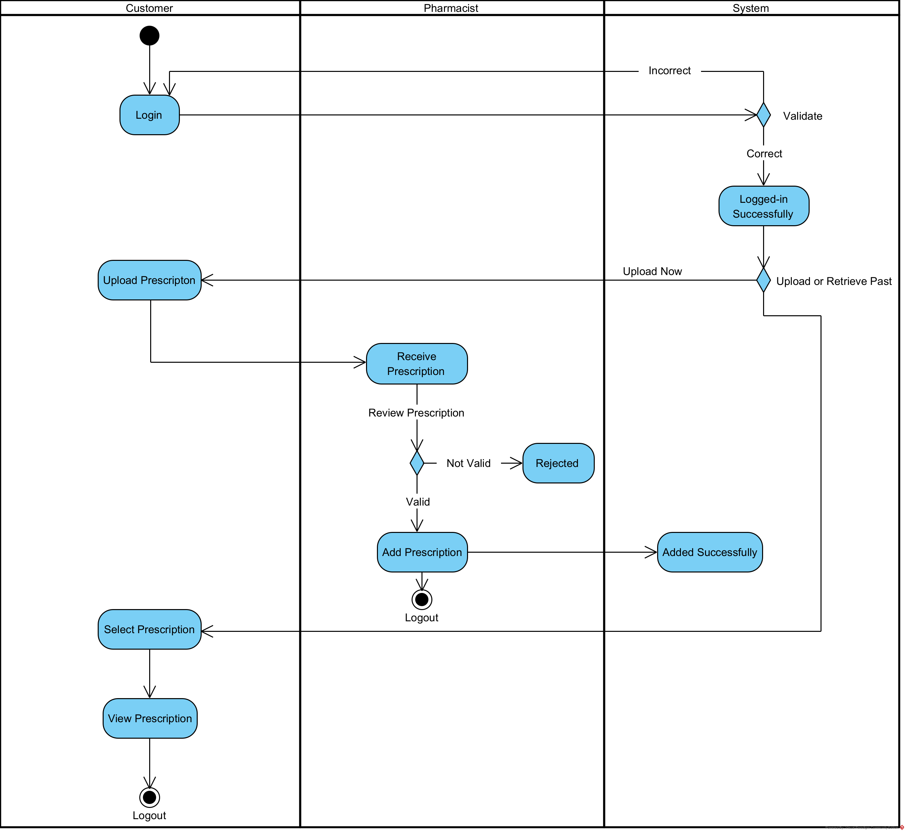
Swimlane Diagram (Prescription):
ER Diagram:

